Slide 1
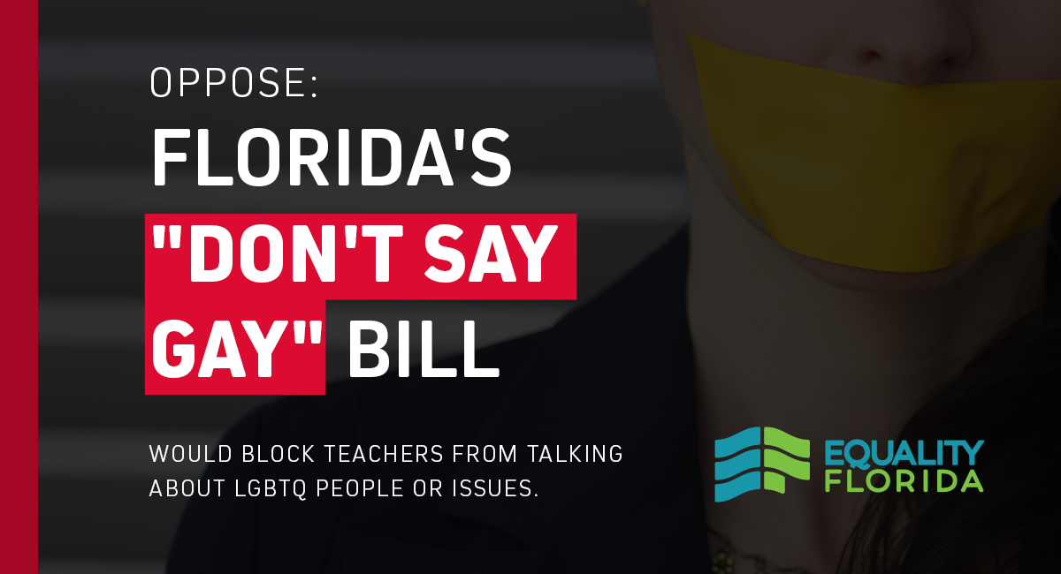
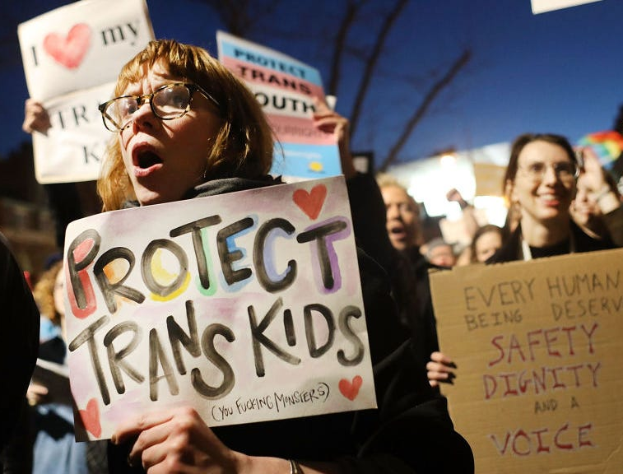
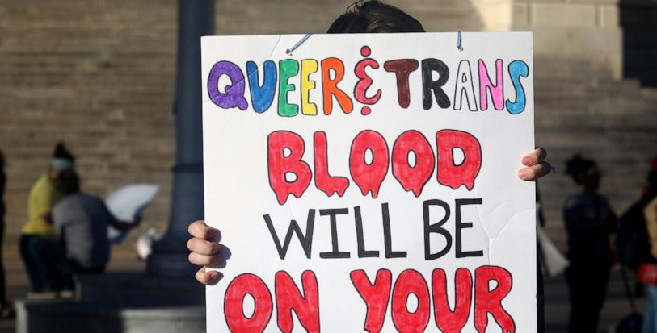
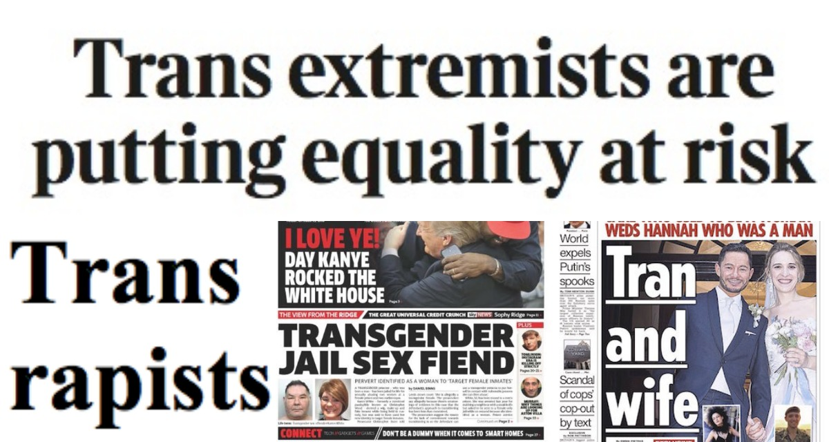
Anti-LGBTQ Legislation: predicting their consequences with hate crimes
Kelvin Nguyen

Slide 2
Project Description
Correlate the number of anti-LGBTQ hate crimes with anti-lgbtq legislation to find if there is any correlation.
Determine if certain types of states create this environment with high law counts and high crime counts.
Hypothesis: there is a correlation between anti-LGBTQ hate crimes and number of anti-LBGTQ legislation counts

Slide 3
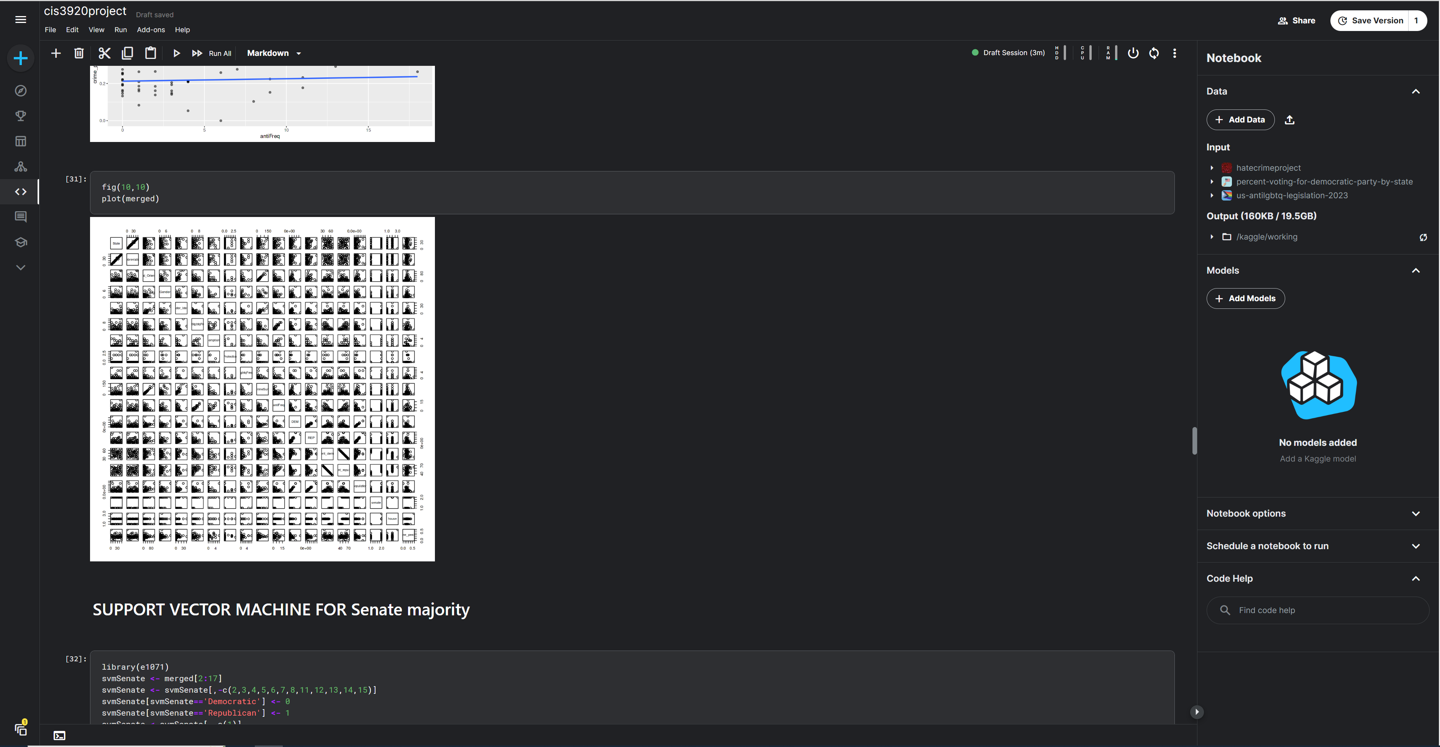
How this works / Datasets Used
Collection of Hate crime statistics and Anti-LGBTQ legislation passed within a year.
Dataset 1: FBI’s hate crime tracker for 2021
Dataset2: ACLU’s legislation tracker for 2021
Dataset3: Ballotpedia’s Senate / House majority for 2020
Dataset4: Kaggle Dataset of US voters for 2020 presidential election and population
Models used:
Linear Regression
Support Vector Machine
Random Forest

Slide 4
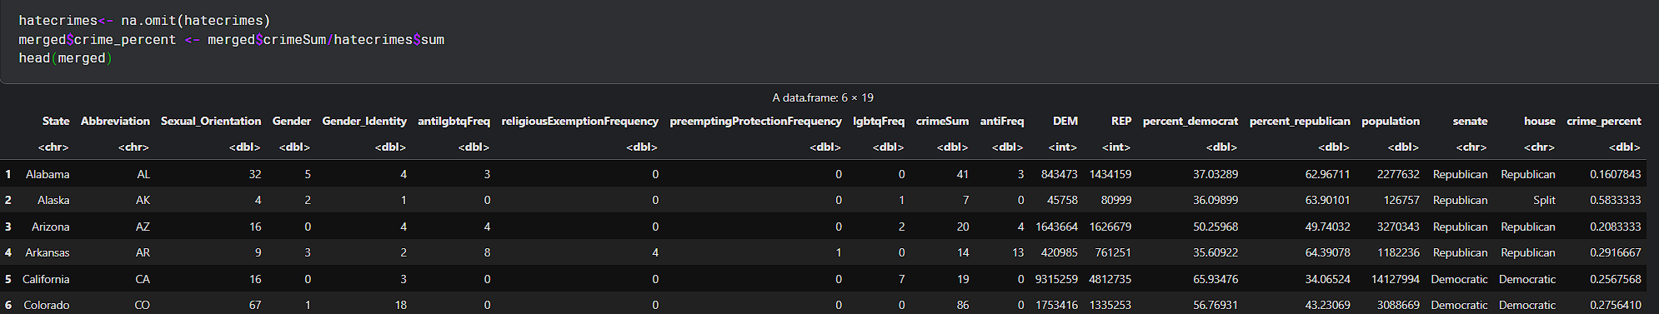
How this works / Datasets Used

Slide 5
Contributions and Previous Studies
Although this project would not have been possible with the American Civil Liberties Union (ACLU) on their work of tracking anti-LGBTQ legislation and the FBI’s Uniform Crime Reporting program (UCR), there have been no previous studies done on the correlation between the two.
This project’s purpose is to investigate whether these laws directly correlate to number of hate crimes or not.
Regardless of these results, it is important to ensure human rights to all, regardless of sexuality or ethnicity.

Slide 6
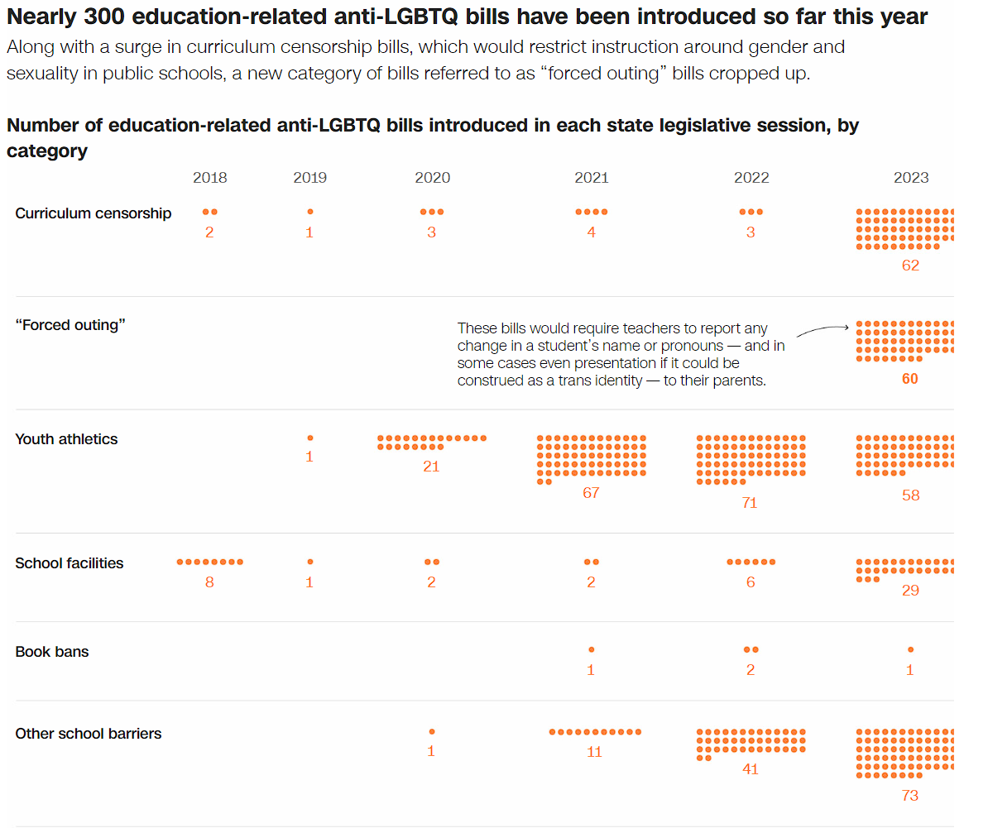
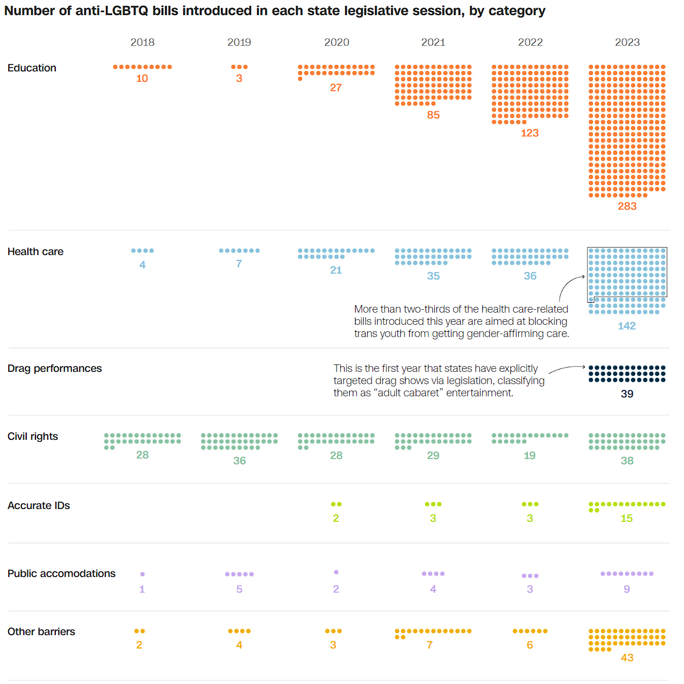
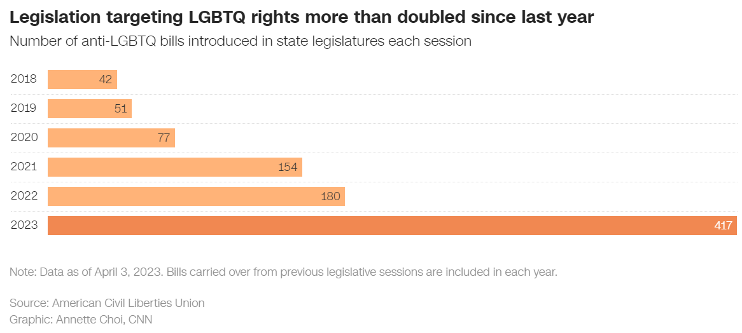
Context

Slide 7
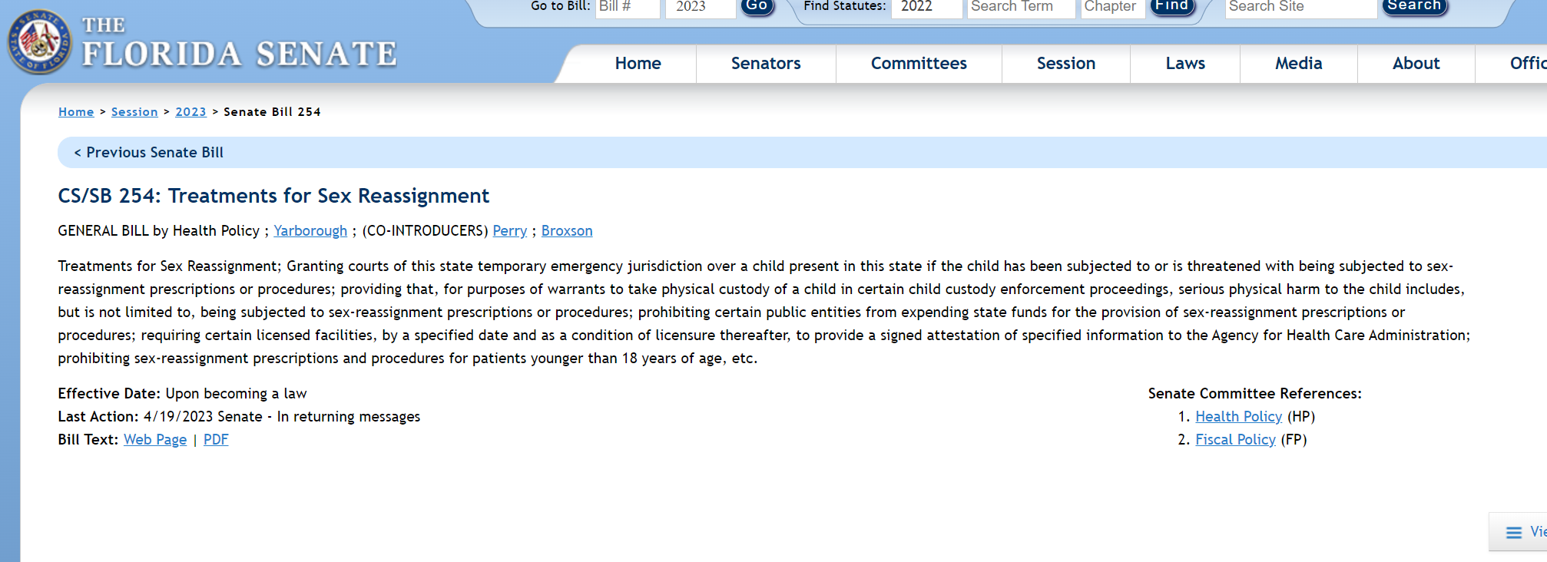
Florida Senate Bill 254 and Article II of UN’s Genocide Convention
Article II In the present Convention, genocide means any of the following acts committed with intent to destroy, in whole or in part, a national, ethnical, racial or religious group, as such: (a) Killing members of the group; (b) Causing serious bodily or mental harm to members of the group; (c) Deliberately inflicting on the group conditions of life calculated to bring about its physical destruction in whole or in part; (d) Imposing measures intended to prevent births within the group; (e) Forcibly transferring children of the group to another group.

Slide 8
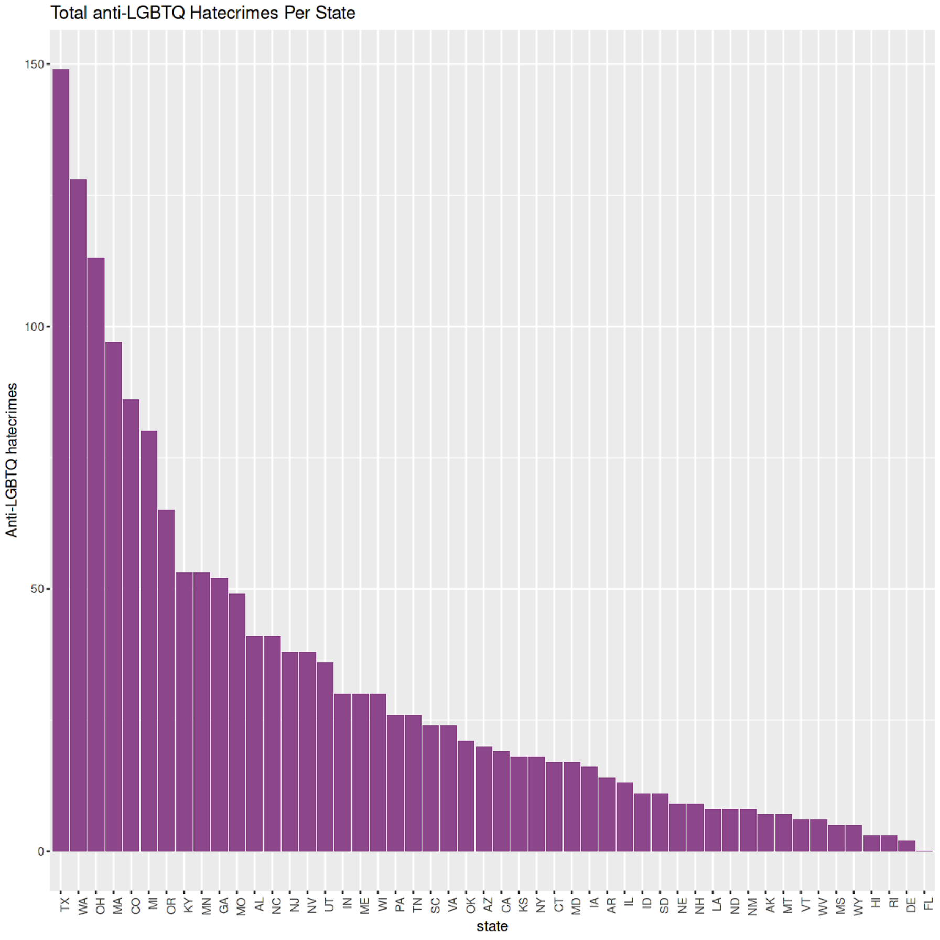
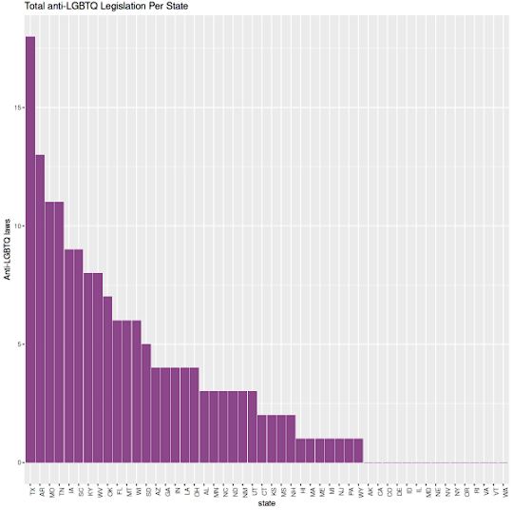
Analysis: Basics
1590 Total
170 Total

Slide 9
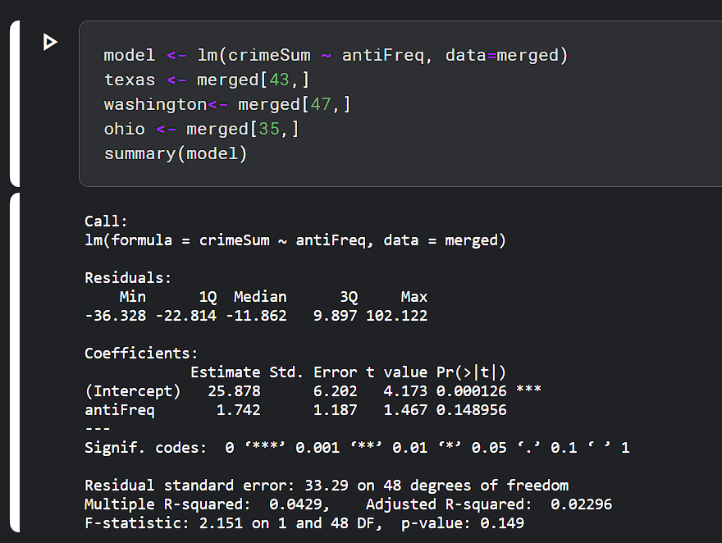
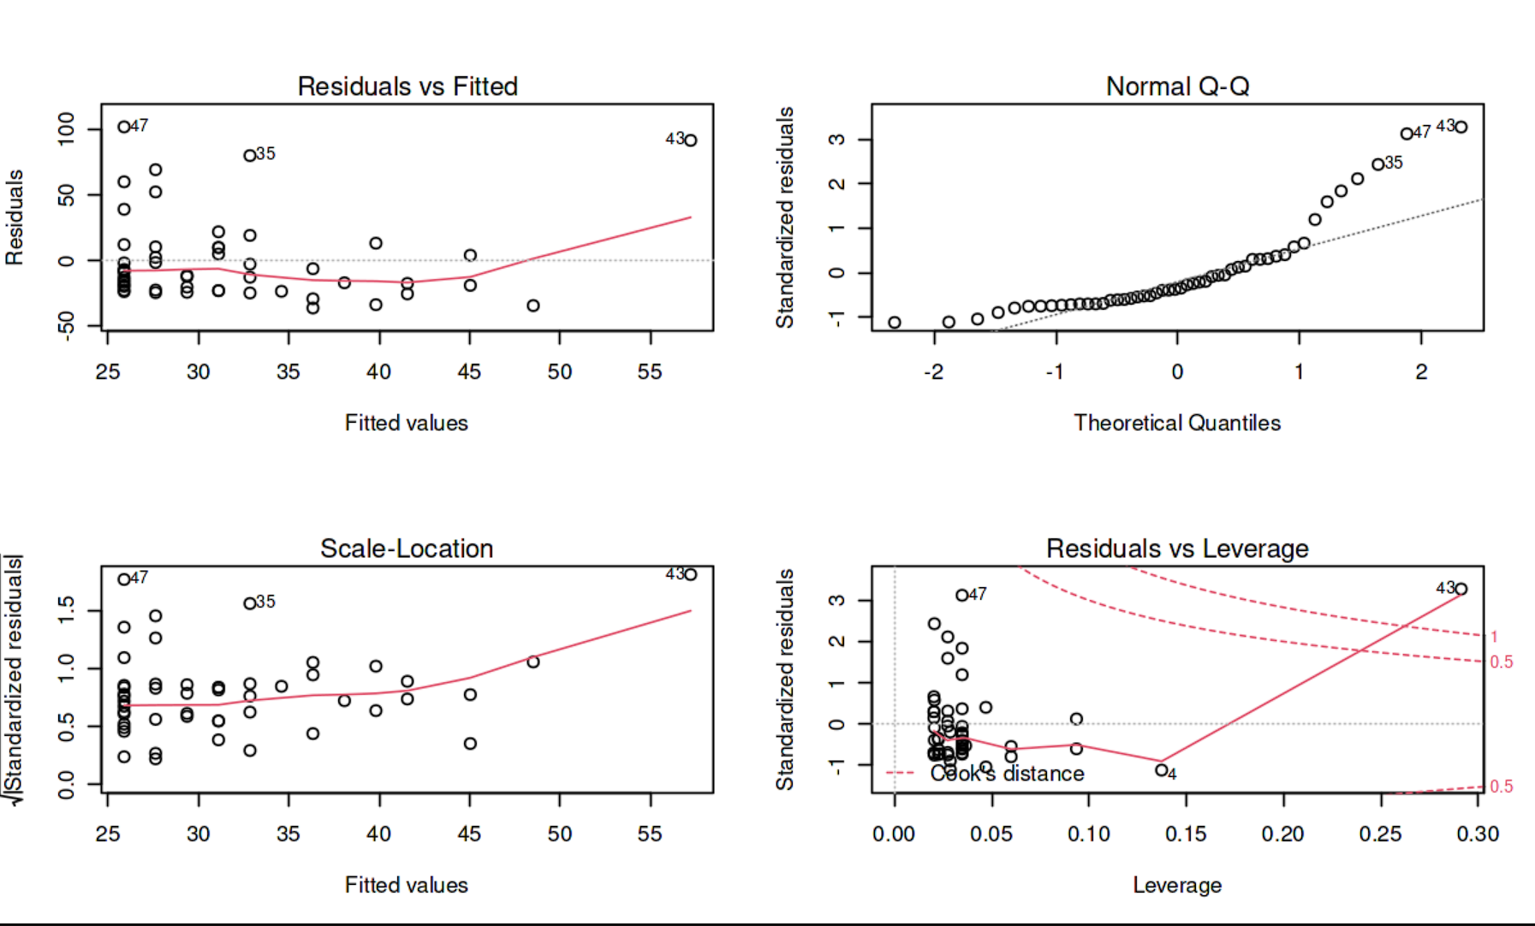
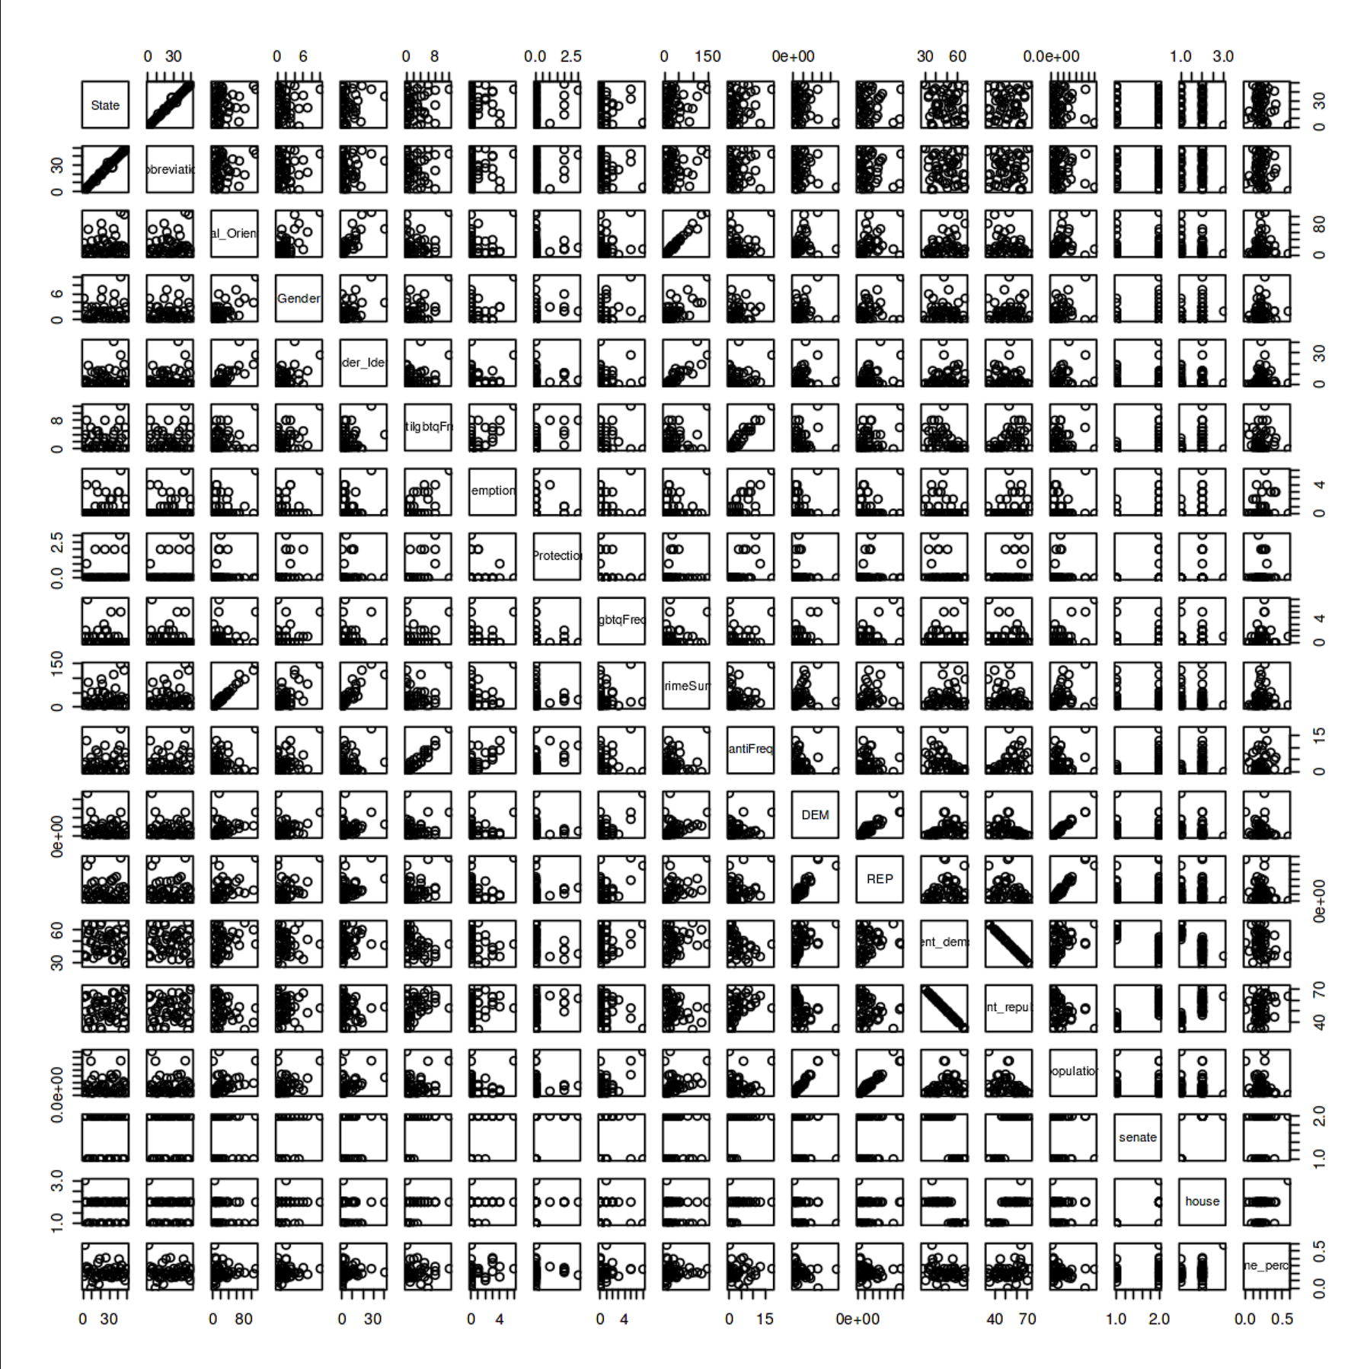
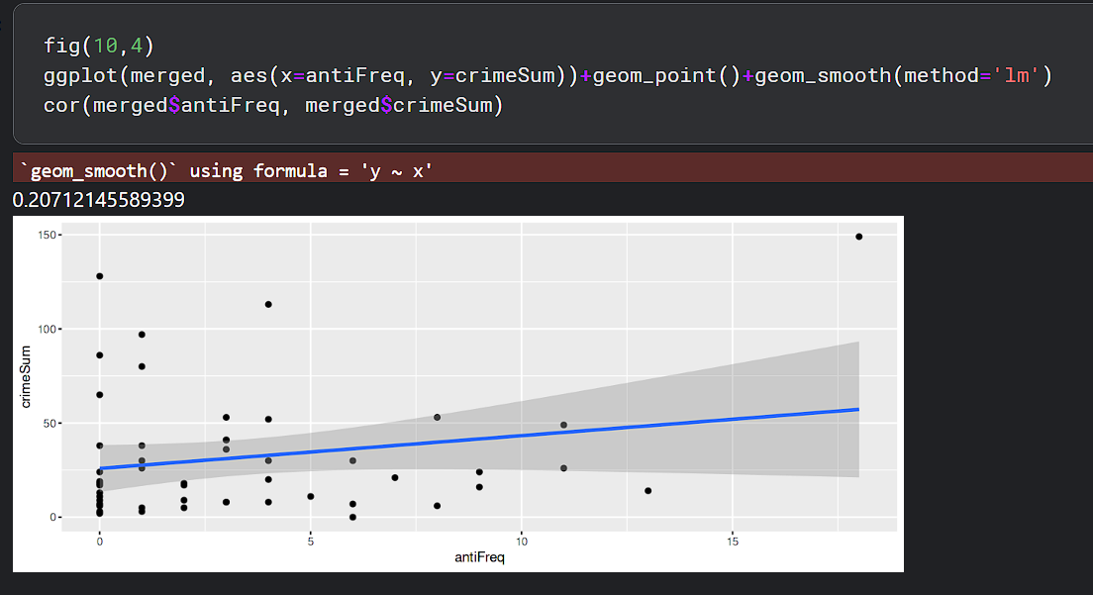
Regression
Poor performance overall, model had too much error
Low P value, messy residuals, heavy outliers

Slide 10
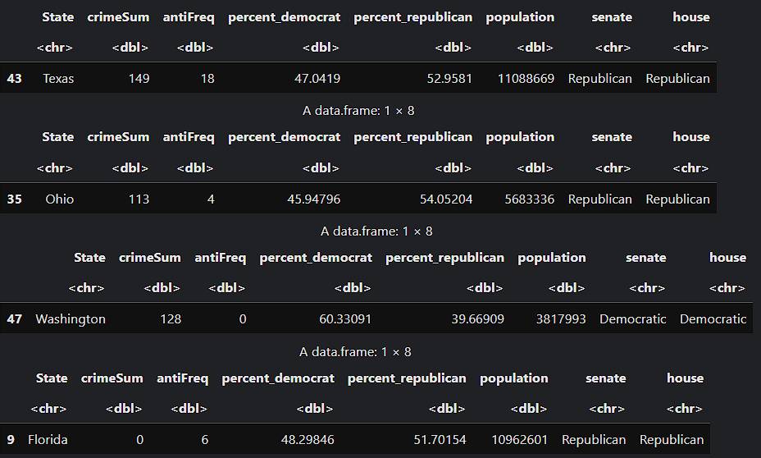
Regression

Slide 11
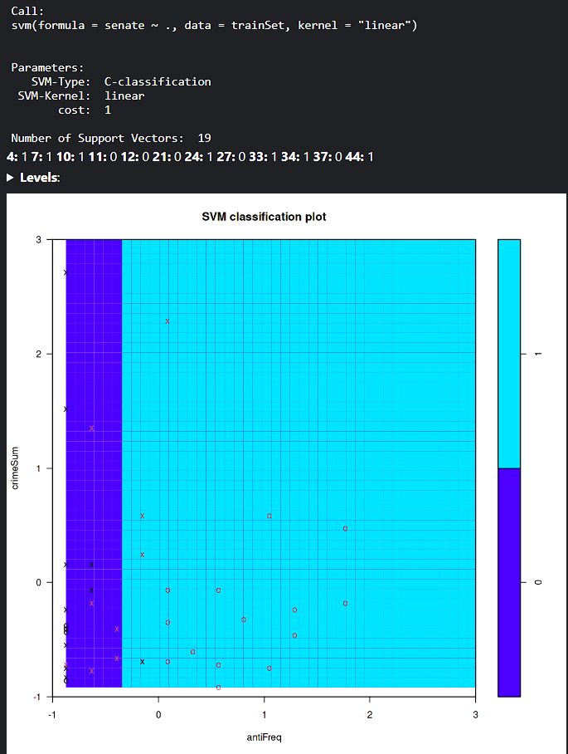
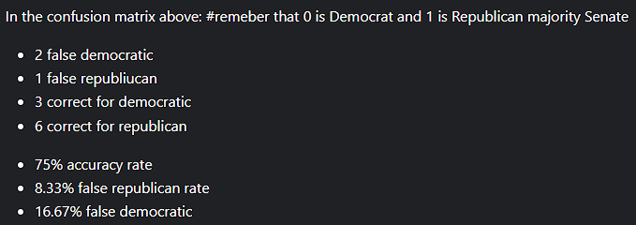
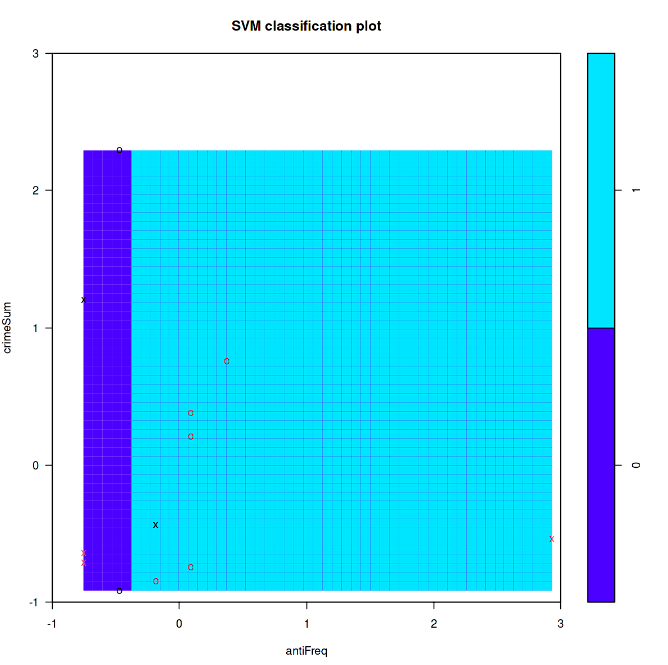
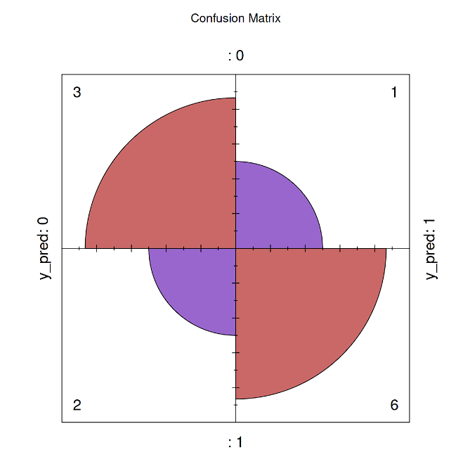
SVM
Training Set
Test Set
Binaries defined are 0 = democratic majority, 1 = republican majority
Performance was mediocre, 75% accuracy rate. not bad, not good.

Slide 12
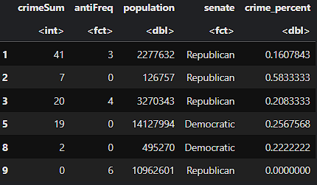
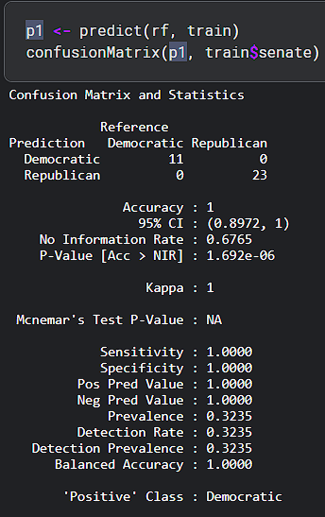
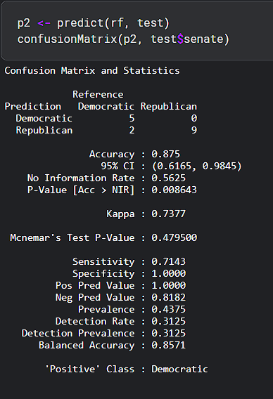
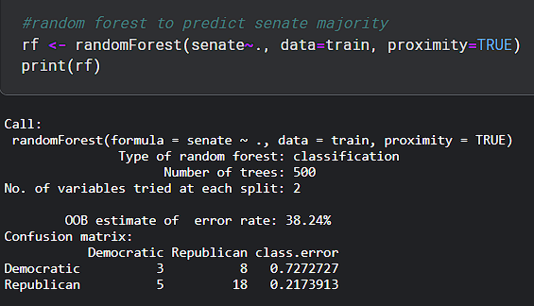
Random Forest
Training
Testing
Predict
Overall good model, great training accuracy of 100% and testing accuracy of 87.5%

Slide 13
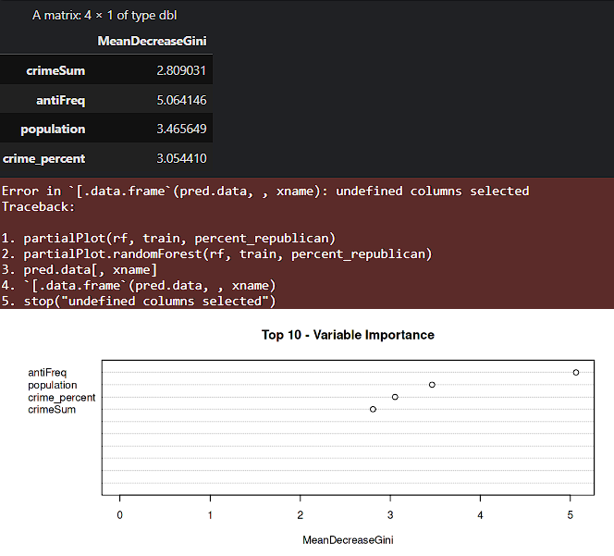
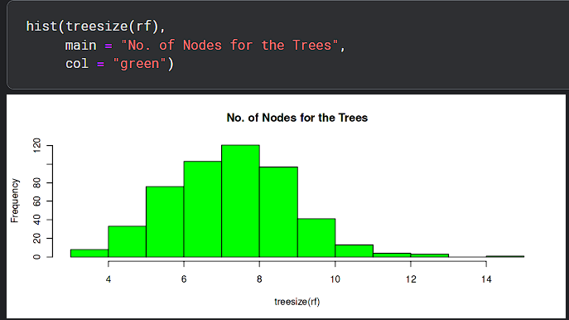
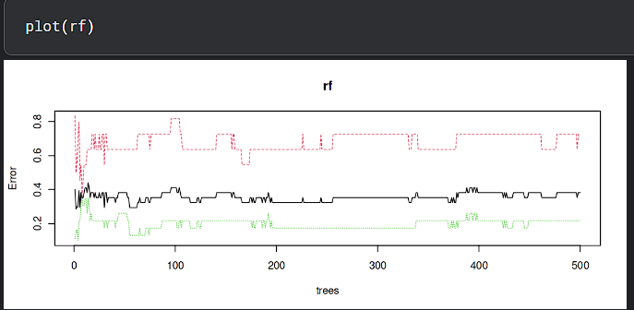
Random Forest

Slide 14
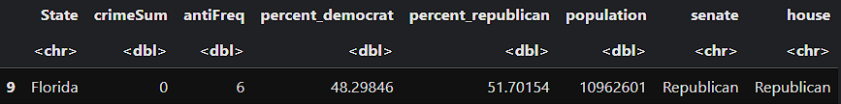
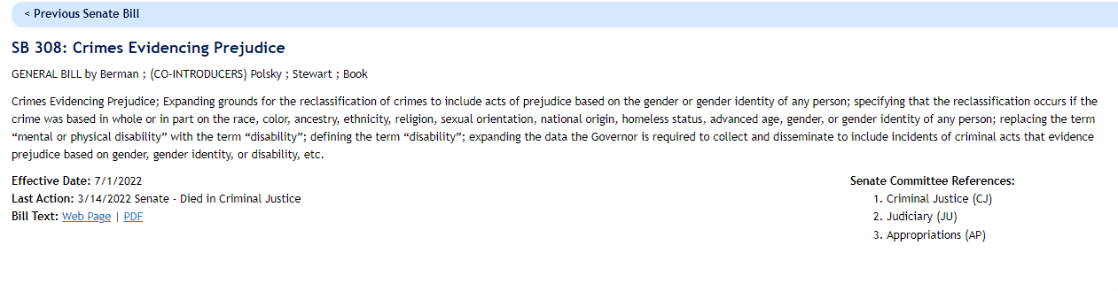
Struggles and Roadblocks
Florida was a huge problem.

Slide 15
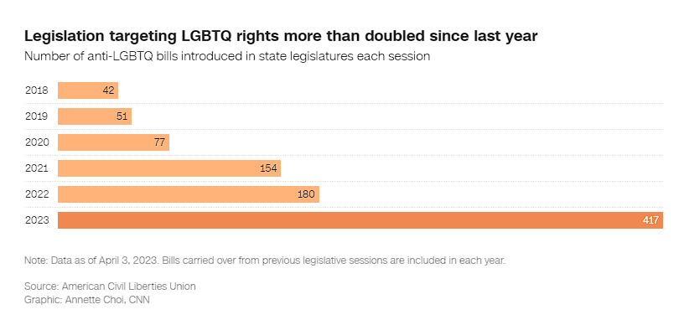
Struggles and Roadblocks

Slide 16
Conclusion: Comments for the Future
My hypothesis was wrong, there is no correlation between number of anti-LGBTQ hate crimes and anti-LGBTQ legislation
However: using both as well as population and federal election results as predictors, Random Forest was able to predict each state’s senate majority with 87.5% testing accuracy
Flaws: I can only use 50 states as data as there are rarely any fluctuations between Senate/House majority per state
Once the 2023 Hate crimes and legislation datasets come out, this will be revisited (estimate within 2 years)
The original but difficult idea was to correlate any form of anti-LGBTQ media/comments from American politicians (specifically tweets) with hate crimes (this can also be applied to racial / disability hate crimes)
Immense amount of machine learning
Huge goal yet small step for human rights

